Slide 1
LED Resistor Value Calculator
GROUP NUMBER
A systematic tool for designing safe, efficient LED circuits — with automatic validation, resistor calculation, power analysis, and batch report generation.

Slide 2
Introduction
Before I explain our program, I'd like to ask everyone a simple question. Have you ever connected an LED directly to a battery? Many beginners do exactly that. Sometimes the LED lights up for a few seconds and then suddenly burns out. Other times it becomes extremely hot or doesn't shine properly. Why does this happen? The answer is simple. An LED cannot control the amount of current flowing through it. Think of an LED as a person drinking water through a straw. If the water pressure is gentle, the person drinks comfortably. But if you connect a fire hose to the straw, the pressure is too much. The person cannot handle it. The LED behaves the same way. Too much current destroys it. That is why every LED requires a current-limiting resistor connected in series. Our software calculates that resistor automatically. Instead of guessing resistor values, users obtain accurate electrical calculations within seconds.
PROBLEM STATEMENT
Many students simply copy resistor values from YouTube videos, laboratory manuals or previous circuits. However, every circuit is different. Changing the battery voltage or changing the LED color changes the electrical requirements. Guessing resistor values may lead to:
Damaged LEDs, poor brightness, wasted components, incorrect circuit operation. Therefore, we developed a C++ application that performs these calculations correctly before the circuit is built.

Slide 3
OBJECTIVES
Our application can:
- receive the LED color or name,
- receive the supply voltage,
- receive the LED forward voltage,
- receive the desired LED current,
- validate user inputs,
- calculate the resistor value,
- calculate the resistor power rating,
- determine whether the design is acceptable,
- display the results clearly,
- save all calculations into a text file

Slide 4

System Overview
What It Does
The calculator accepts LED circuit parameters, validates inputs, computes the required resistor value and power dissipation, flags high-current designs, and saves a complete report to led_resistor_report.txt.
Core Workflow
Enter the number of LED calculations (N)
Loop through each LED circuit entry Validate, calculate, and save results
Close file and confirm on completion

Slide 5

Step 1: System Initialization
Display System
Launch the LED Resistor Value Calculator interface.
Enter N
Input the number of LED circuit calculations to perform.
Create Report File
Open led_resistor_report.txt for writing results.
Set Counter
Initialize loop counter i = 1.

Slide 6
Step 2: LED Input Parameters
For each LED circuit, the user enters four required values:
1
2
LED Name
A label to identify the circuit in the report.
Supply Voltaąe (Vs)
The source voltage powering the circuit, in volts.
3
4
Forward Voltaąe (Vf)
The LED's forward voltage drop, in volts.
LED Current (If)
Desired current through the LED, in milliamperes (mA).

Slide 7

Step 3: Input Validation
Validation Rules
Each input is checked before calculation. If any rule fails, the design is marked "Design Invalid":
Invalid results are displayed and saved to the report file before continuing.
Vs ≤ 0 → Invalid Supply Voltage
Vf ≤ 0 → Invalid Forward Voltage
Vs ≤ Vf → Invalid Design
If ≤ 0 → Invalid Current Value

Slide 8

Step 4: Resistor Calculations
When inputs pass validation, the system performs three sequential calculations:
Convert Current
Calculate Resistor
Calculate Power
These formulas ensure the correct resistor is selected to safely limit current through the LED while accounting for power dissipation.

Slide 9


The Core Formulas
Current Conversion
Resistor Value
Resistor Power
P = I² × R
I = I_{f} ÷ 1000
_{R =} (V_{s} − V_{f} )
I
Converts milliamperes to Amperes for calculation.
Determines minimum power rating for the resistor.
Ohm's Law applied to the LED series resistor.

Slide 10


Step 5: High-Current Warning
Current Safety Check
After a valid design is accepted, the system checks:
Is If > 30 mA? If yes, display: "Warning: LED current may be too high for a standard LED."
This protects against overdriving standard LEDs, which typically operate safely at ≤ 20 mA. The warning is recorded alongside results but does not invalidate the design.

Slide 11



Step 6: Results & Report Output
For every LED circuit — valid or invalid — results are displayed and saved to led_resistor_report.txt:
Displayed Results
LED Name, Vs, Vf, If (mA), I (A),
R (Ω), P (W), Design Status, and any warning message.
Saved to File
All results are written to the report file for each iteration of the loop.
Completion Messaąe
After all N calculations: "Report saved successfully." File is closed and system ends.

Slide 12
ALGORITHM
LED Resistor Value Calculator System
1. Start the program.
2. Display the program title: "LED Resistor Value Calculator System".
3. Ask the user to enter the number of LED circuit calculations to perform.
4. Repeat the following steps for each LED circuit:
a. Prompt the user to enter:
●LED name
●Supply voltage (Vs)
●Forward voltage ( Vf )
●LED current (If) in milliamperes (mA)
b. Validate the inputs:
●Supply voltage must be greater than 0.
●Forward voltage must be greater than 0.
●Supply voltage must be greater than forward voltage.
●LED current must be greater than 0.
●If any input is invalid, display an error message and ask the user to enter the values again.
c. Convert LED current from milliamperes to amperes:
I= current/1000
d. Calculate the resistor value:
R= Vs- Vf /I
e. Calculate the resistor power:
P=(Vs- Vf)×I
f. Determine the design status:
If all inputs are valid, display ●"Design is Safe".
●Otherwise, display "Design is Invalid".
g.
Display:
●LED name
●Supply voltage
●Forward voltage
●LED current (mA and A)
●Calculated resistor value (Ω)
●Calculated resistor power (W)
●Design status
h. Save the calculation results to a text file.
5. End the loop after all LED circuits have been processed.
Display a message: "Report saved successfully."
6. End the program.

Slide 13
PSEUDOCODE
SET Resistor = (Vs - Vf) / I
SET Power = I * I * Resistor
IF Resistor <= 0 THEN
Status = "INVALID"
ELSE IF Power > 0.25 THEN
Status = "WARNING: Use a resistor with a higher power rating."
ELSE
Status = "ACCEPTED"
ENDIF
BEGIN
OPEN "led_resistor_report.txt" FOR writing
DISPLAY "===== LED RESISTOR VALUE CALCULATOR SYSTEM ====="
REPEAT
INPUT LED_Name
INPUT Supply_Voltage (Vs)
INPUT Forward_Voltage (Vf)
INPUT LED_Current (I)
IF Vs <= 0 OR Vf <= 0 OR I <= 0 THEN
DISPLAY "Invalid input. Values must be greater than zero."
CONTINUE
ENDIF
IF Vf >= Vs THEN
DISPLAY "Invalid circuit. Forward voltage must be less than supply voltage."
CONTINUE
ENDIF
DISPLAY "------------------------------------"
DISPLAY "LED Name: ", LED_Name
DISPLAY "Supply Voltage: ", Vs, " V"
DISPLAY "Forward Voltage: ", Vf, " V"
DISPLAY "LED Current: ", I, " A"
DISPLAY "Recommended Resistor: ", Resistor, " Ohms"
DISPLAY "Minimum Power Rating: ", Power, " Watts"
DISPLAY "Circuit Status: ", Status
DISPLAY "------------------------------------"
WRITE all report details to "led_resistor_report.txt"
INPUT "Do you want to calculate another LED? (Y/N): ", Choice
UNTIL Choice = 'N' OR Choice = 'n'
CLOSE "led_resistor_report.txt"
DISPLAY "Report saved successfully."
END

Slide 14
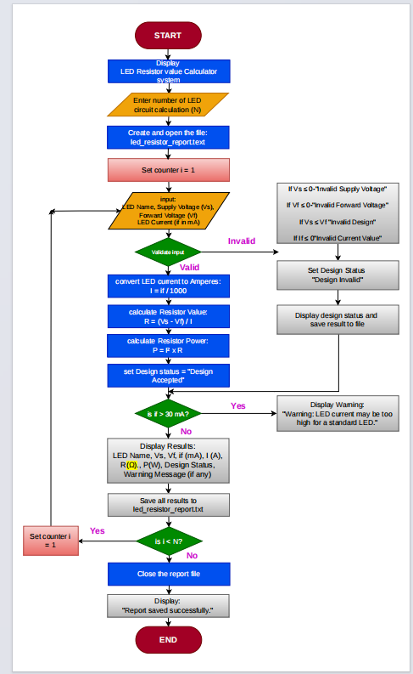
Full Flowchart at a Glance
The system loops through all N LED circuits, validating inputs, calculating resistor values and power, flagging high-current designs, and saving a complete report before closing.

Slide 15
IMPLEMENTATION
SYSTEM IMPLEMENTATION
The LED Resistor Value Calculator System was developed using C++ with an object-oriented programming approach. The application : Accepts the LED name, supply voltage, forward voltage, and desired current. Validates all user inputs to prevent invalid circuit designs. Converts current from milliamperes (mA) to amperes (A).Calculates the required resistor value using Ohm's Law. Calculates the minimum resistor power rating. Displays the design status (Accepted, Invalid, or Warning).Saves all calculation results to led _ resistor _ report.txt. Supports multiple LED calculations in a single program execution.

Slide 16
CONCLUSION
The LED Resistor Value Calculator System successfully combines electrical engineering principles with C++ programming to provide accurate resistor calculations for LED circuits. The application minimizes calculation errors, improves circuit safety, and simplifies the LED design process through automatic calculations, input validation, and report generation. This project demonstrates the practical application of programming in solving real-world engineering problems and highlights the importance of software tools in electrical circuit design.

Slide 17
GROUP CONTRIBUTION
STUDENT | SUGGESTED ROLE
Bright Odoom - 01242600B | Project lead
Asamoah Dorcas kissi - 01244084B | Algorithm writer
Micheal Osei Bormor - 01246900B | PSeudocode writer
Awudu Wuzeima - 01243137B | Flowchart designer
Aboagye Jonas Frimpong - 01241449B | C++ programmer
Christopher Monney – 01243455B | c++ programmer
Ayitey Aaron - 01246384B | Testing lead
Juliet Normenyo – 01244425B | Github manager
Oppong-Duah Immanuel - 01243256B | Documentation lead
Perida Naa Larley Aba Lartey- 01245581B | Presentation lead

Slide 18
THANK YOU

